Slide 1


CARS_24 ANALYSIS
by Sanne Venkat Susheel

Slide 2

ABOUT CARS_24:
24M
5K
100K
Listings
Cities
Transactions
Over 24 million vehicles listed on the Cars_24 platform
Available in over 5,000 cities across India
Facilitating over 100,000 vehicle transactions per month
Cars_24 is a leading online platform for buying, selling, and exchanging used vehicles in India. With a vast inventory of over 24 million listings spanning 5,000 cities, Cars_24 connects buyers and sellers seamlessly, facilitating over 100,000 vehicle transactions per month.

Slide 3

STEPS FOR ANALYSIS:
Data Collection
Data Cleaning
Data Exploration
Data Transformation
Data Loading
Data Visualization
Data Deployment

Slide 4




TOOLS:
Excel
Python
MySQL
In this tool, we have extracted the file to excel where,we have created some charts , added multiple slicers to filter the data and ended withan dashboard.,
In this tool, we have extracted the data from webpage using web scraping , selenium and converted the data into file.
In this tool, we have extracted the file to mysql and created some interesting quereis based on the Car(Brands,Model,etc.,)

Slide 5

ANALYSIS USING PYTHON:
In this Tool we will be extracting the cars_24 data to python using Selenium and Web_scraping, where we will be scraping the data of two mtero_politan cities . i.e., Hyderabad and Delhi. Where, In Hyderabad we extracted 618 records and in Delhi 849. And we converted the whole data into suitable column with suitable rows & we converted the data to CSV file through Pandas Module.,

Slide 6

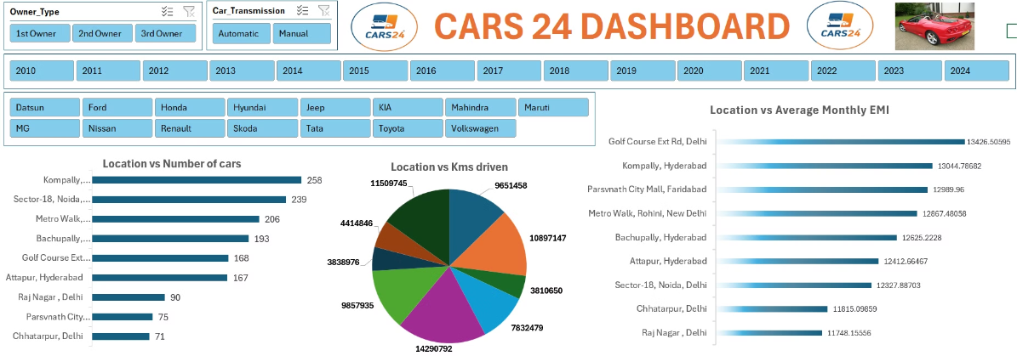
ANALYSIS USING EXCEL:
In this Tool we will be extracting the cars_24(csv) file to Excel. where we created some charts using Pivot_table and above dashboard, tells more clear that Hyderabad(Kompally) city has more number of cars & 2nd most in Avg Monthly EMI as well. In Avg_monthly_EMI we got Delhi the most and No.of KM's Driven as well. Clear Insights and Data_driven decisions to be taken by filtering the Year, Owner_Type and Brand slicers as well.,

Slide 7

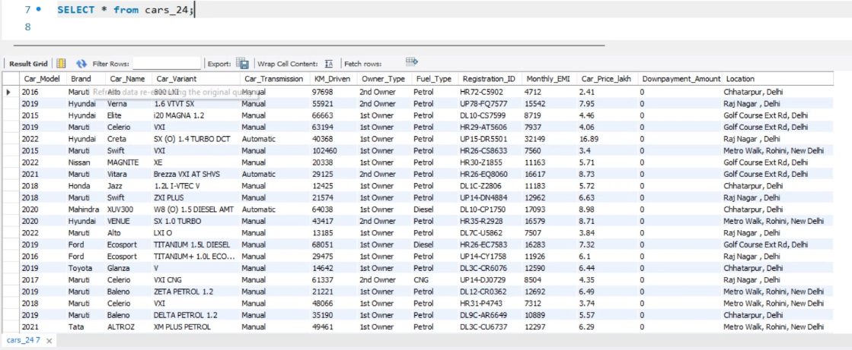
ANALYSIS USING MYSQL:
In this tool we will be importing the same csv_file into Mysql, where we have columns like Car_Model, Brand, Car_Name, Variant, KM's driven and so on., And In this we can find insights using some Aggregate functions like (sum, avg, count,etc.,), Advance functions like Sub_query, and some Window functions include rank,dense_rank, row_number, lag, lead,ntile, etc., These can be done easy for the data to drive through the insights and Analysis by Year_on_Year analysis , Highest and Lowest_car_price and so on

Slide 8


CONCLUSION:
We look forward to increase in the accuracy of cleaning and transforming the data from web_sites and try to make more analysis to forecast the future trends and see the data very clearly.,

